Slide 1
Stock Selection
Decision Support System

Slide 2
Outline
The problem
Data description
Statistical methods
Result interpretation

Slide 3


What’s the problem?
How to pick stocks that fit my requirements?
Students, can you build a decision supporting model for him?

Slide 4
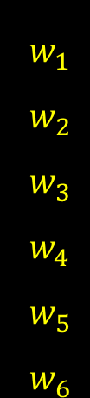


What’s the problem?
$$f$$
$$w_{1}$$
$$w_{2}$$
$$w_{3}$$
$$w_{4}$$
$$w_{5}$$
$$w_{6}$$
BP
ROE
S/P
Return Rate in last quarter
Market Value
Systematic Risk
Annual Return Rate
Excess return
Systematic risk
Total risk
Absolute win rate
Relative win rate
$$y_{1}$$
$$y_{2}$$
$$y_{3}$$
$$y_{4}$$
$$y_{5}$$
$$y_{6}$$
Stock Database
Notes:
Each stocks has 6 scoring-factors available in stock historical data
Investors use these factors to choose stocks to put in the portfolio
When the investor weighs these scoring-factors differently, he will end up with different portfolios whose performance can be measured by these indicators
The idea of weighing these scoring-factors can be expressed as applying a set of weights to these factors
The question is to model the relationship between w and y
Model is used to optimize investor’s outcomes
Give one example about risk and one example about return

Slide 5

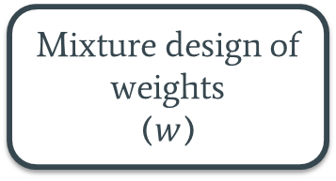


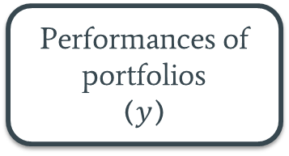
Data description
20 years of data divided into 4 time frames
1 time frame – training set | The rest – test set
Stock market database
$$\sum{weights=1}$$
Mixture design of weights
($w$)
Backtesting with weighted scoring
Performances of portfolios
($y$)
$2^{6}−1=63$ sets of weights
(or 63 strategies)
Notes:
To build a model we need the data
Our data pairs a set of weights with a set of performance indicators
Let’s focus on weights. We assume that the sum of weights is 1. We use mixture design to generate 63 combinations of weights.
To generate performance indicators values, we use the weights and stock market database to form portfolios and generate performance indicators accordingly
Now the data is ready for model making

Slide 6


Statistical methods
Linear Regression
Neural Networks
$$f$$
$$f$$
Notes:
We use 2 statistical methods: Linear regression and Neural Networks.

Slide 7
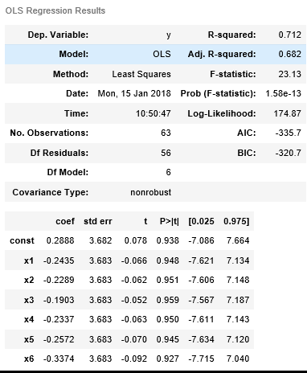
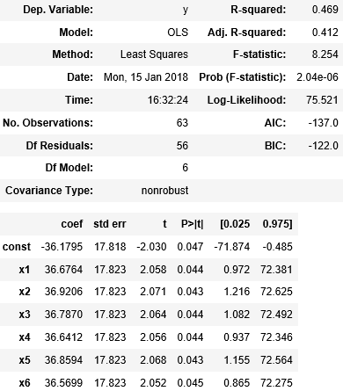
Results – Linear Regression
Annual return rate (period 4)
Relative winning rate (period 4)
Notes:
With linear regression, we wonder if our model is a good fit. With the null hypotheses, where all the coefficients are 0, we observe the p-value.
P-values in most cases are very high, making it clear that we cannot reject the hypotheses, meaning the relationship between the weights and the performance indicators cannot be well-described using a linear model. There is only one case where p-values are found to be smaller than the 0.05 significant level. Howevier, the goodness of fit is low, indicating the model is underfit

Slide 8
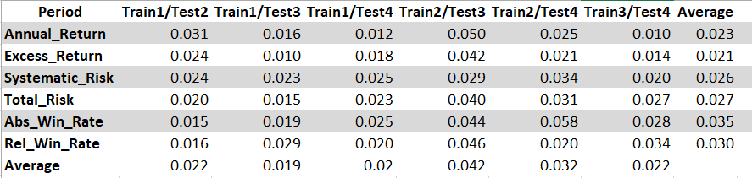
Results – Neural Networks
Mean Square Error
Notes:
Overall the MSE is quite acceptable, around 0.04

Slide 9
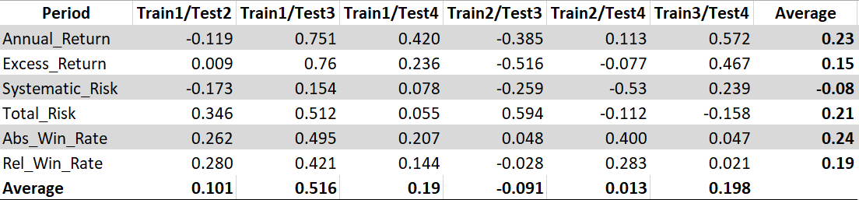
Results – Neural Networks
Correlation coefficients of the predictive models in testing periods
Notes:
Low correlation between actual and predictive values -> it is difficult to predict future investment performances

Slide 10
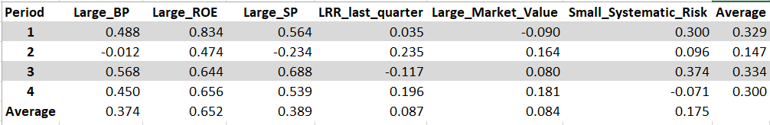
Results – Neural Networks
Effects of weights on Excess Return Rate
Notes:
Besides building the networks, we also consider the effects of each weight on each performance indicator.
The table show the effect of weights on Excess return rate
For example: ….

Slide 11


Summary
$$f$$
weights
Performance indicators

